Slide 1


Cloud and Edge Computing for Data Science
24
PART V · DATA SCIENCE IN SYSTEMS CONTEXT
CHAPTER 24 · WEEK 14
Data Science — From Foundations to Intelligent Systems
LECTURER
Dr. Mustafa Hameed
THE ISLAMIA UNIVERSITY OF BAHAWALPUR
Bahawalpur, Pakistan
Department of Information Technology · BSIT · Fall 2026
Notes:
Chapter 24: Cloud and Edge Computing for Data Science. Part 5 — Data Science in Systems Context. Week 14: Data engineering; cloud and edge. Handout pages 156–161.

Slide 2

Where this chapter sits
THE COURSE
PART I
PART II
PART III
PART IV
PART V
PART VI
1
2
3
4
5
6
7
8
9
10
11
12
13
14
15
16
17
18
19
20
21
22
23
24
25
26
27
28
29
30
31
32
Cloud and Edge Computing for Data Science
BUILDS ON
USED LATER IN
Ch 23 Data Engineering at Scale
Ch 25 Data Science for the Internet of Things
Ch 27 MLOps: Deployment, Monitoring and Reliability
Data Science · Chapter 24 · Cloud and Edge Computing for Data Science
Handout p. 156 2
Notes:
Place the chapter. Before you start: Chapter 23 (pipelines and storage). This chapter supplies the deployment substrate for Chapter 25 and Chapter 27.

Slide 3

What you will be able to do
LEARNING OUTCOMES
By the end of this chapter you will be able to:
1
Distinguish IaaS, PaaS and SaaS, and say who is responsible for what in each.
2
Explain how containers differ from virtual machines and why that matters for reproducibility.
3
Choose between cloud, fog and edge placement for a given inference workload.
4
Estimate and control the cost of a data science workload.
5
Apply the shared responsibility model to a cloud deployment.
Data Science · Chapter 24 · Cloud and Edge Computing for Data Science
Handout p. 156 3
Notes:
Read these out: they are the chapter's contract with the room. Each click adds one.

Slide 4

Vocabulary for this chapter
KEY TERMS
IaaS / PaaS / SaaS
public, private, hybrid cloud
elasticity
virtual machine
container
image
Kubernetes
serverless
GPU
cloud, fog and edge
latency
quantisation
shared responsibility
data residency
egress cost
Each term is defined where it first matters — not here.
Data Science · Chapter 24 · Cloud and Edge Computing for Data Science
Handout p. 156 4
Notes:
Do not define these now; they arrive one at a time. This slide is for the students' notes. Terms: IaaS / PaaS / SaaS; public, private, hybrid cloud; elasticity; virtual machine; container; image; Kubernetes; serverless; GPU; cloud, fog and edge; latency; quantisation; shared responsibility; data residency; egress cost.

Slide 5

In this chapter
IN THIS CHAPTER
24.1
Service Models
p. 156 ›
24.2
Virtual Machines, Containers, Serverless
p. 157 ›
24.3
Cloud, Fog and Edge
p. 157 ›
24.4
Cost and the Shared Responsibility Model
p. 158 ›
Data Science · Chapter 24 · Cloud and Edge Computing for Data Science
Handout pp. 156–161 5
Notes:
The route through the chapter. Each row is a link: click it to jump to that section in the slide show.

Slide 6
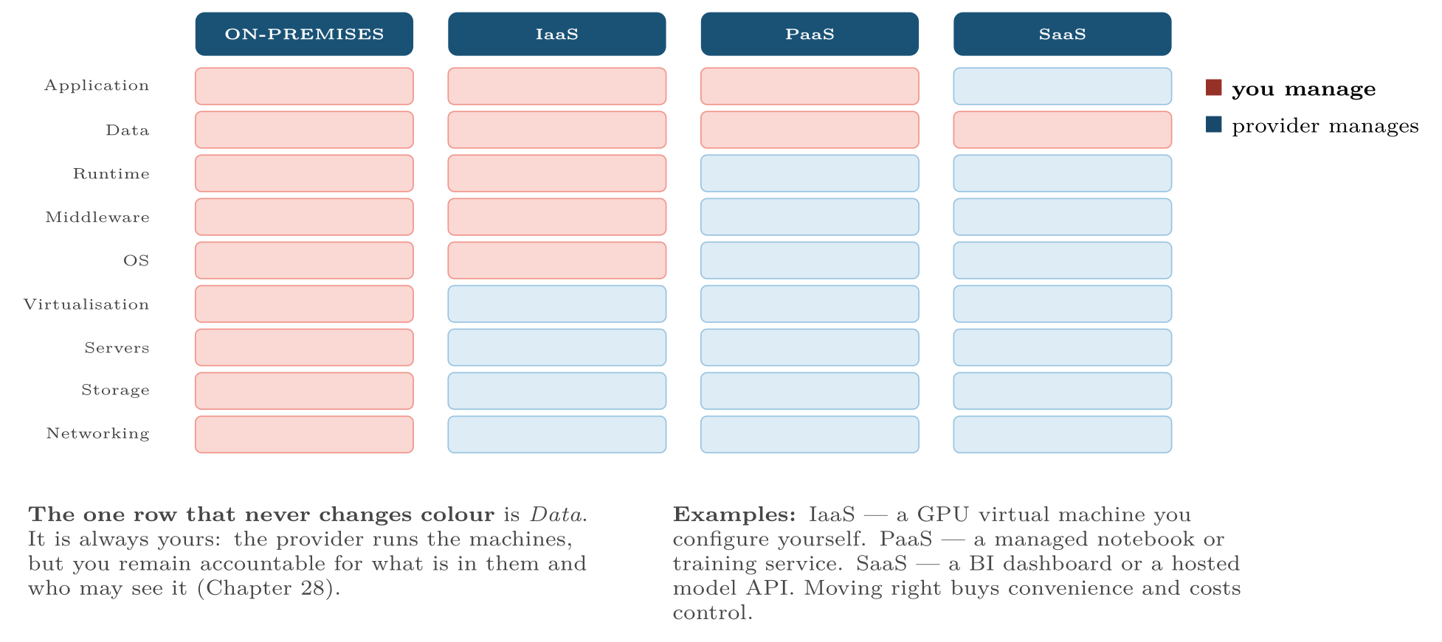
The service models as a stack of responsibilities
FIGURE 24.1
Reading which layers are yours tells you exactly what you must secure, patch and pay for.
Data Science · Chapter 24 · Cloud and Edge Computing for Data Science
§24.1 · Handout p. 156 6
Notes:
Figure 24.1 (handout p. 156): The service models as a stack of responsibilities. Reading which layers are yours tells you exactly what you must secure, patch and pay for.

Slide 7
Virtual Machines, Containers, Serverless
SECTION 2 OF 4
24.2
24.1 Service Models
24.2 Virtual Machines, Containers, Serverless
24.3 Cloud, Fog and Edge
24.4 Cost and the Shared Responsibility Model
Data Science · Chapter 24
Handout §24.2 7
Notes:
Pause. Name the question this section answers.

Slide 8

Container
DEFINITION
A package containing an application together with its libraries and configuration, sharing the host operating system kernel rather than running a full guest OS. Starts in under a second, measured in megabytes, and runs identically wherever it is deployed.
Data Science · Chapter 24 · Cloud and Edge Computing for Data Science
§24.2 · Handout p. 157 8
Notes:
Read the box aloud, then ask for an example from the room before moving on.

Slide 9
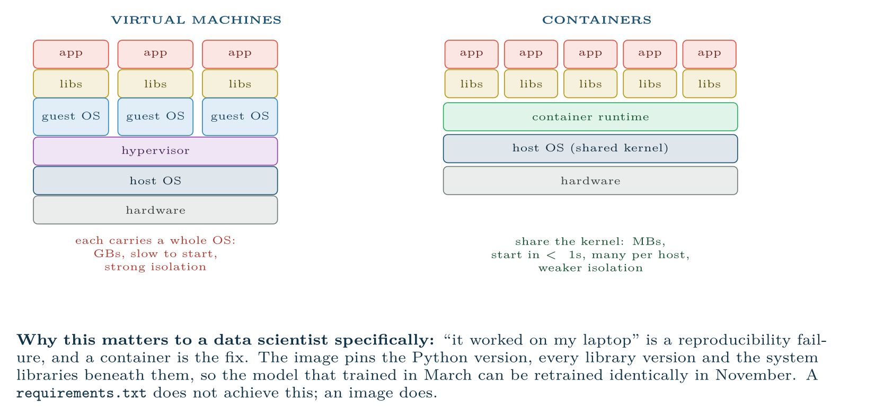
Virtual machines versus containers
FIGURE 24.2
For data science the decisive property is not efficiency but reproducibility: the container image is an exact, versioned record of the environment a result was produced in.
Data Science · Chapter 24 · Cloud and Edge Computing for Data Science
§24.2 · Handout p. 157 9
Notes:
Figure 24.2 (handout p. 157): Virtual machines versus containers. For data science the decisive property is not efficiency but reproducibility: the container image is an exact, versioned record of the environment a result was produced in.

Slide 10

Serverless
CONCEPT
You supply a function; the provider runs it on demand and bills per invocation. Nothing is running — or being paid for — between calls. Excellent for intermittent, short, stateless work such as scoring a single record on arrival. Poor for long training jobs, for anything needing a GPU, and for workloads sensitive to the cold start delay on the first call after an idle period.
Data Science · Chapter 24 · Cloud and Edge Computing for Data Science
§24.2 · Handout p. 157 10
Notes:
Read the box aloud, then ask for an example from the room before moving on.

Slide 11
Cloud, Fog and Edge
SECTION 3 OF 4
24.3
24.1 Service Models
24.2 Virtual Machines, Containers, Serverless
24.3 Cloud, Fog and Edge
24.4 Cost and the Shared Responsibility Model
Data Science · Chapter 24
Handout §24.3 11
Notes:
Pause. Name the question this section answers.

Slide 12
Edge, Fog and Cloud
DEFINITION
Edge: computation on or beside the device that generates the data. Fog: an intermediate tier — a gateway or local server serving a site. Cloud: centralised, effectively unlimited compute, far away in network terms.
Data Science · Chapter 24 · Cloud and Edge Computing for Data Science
§24.3 · Handout p. 157 12
Notes:
Read the box aloud, then ask for an example from the room before moving on.

Slide 13
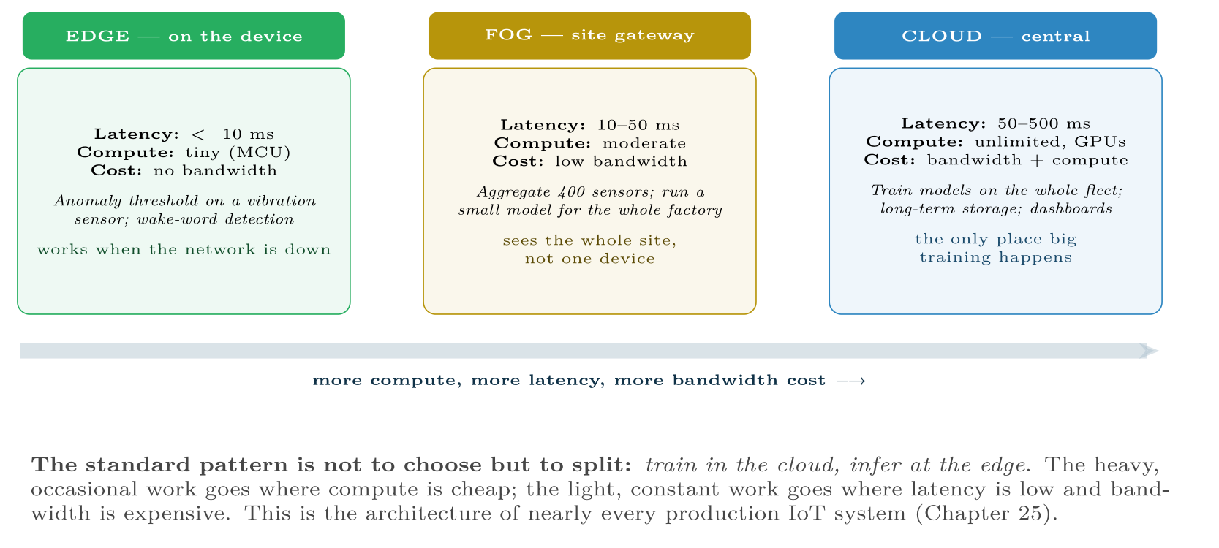
The three tiers
FIGURE 24.3
Placement is decided by the latency the decision requires and the bandwidth you can afford — not by where the computation is most convenient to write.
Data Science · Chapter 24 · Cloud and Edge Computing for Data Science
§24.3 · Handout p. 157 13
Notes:
Figure 24.3 (handout p. 158): The three tiers. Placement is decided by the latency the decision requires and the bandwidth you can afford — not by where the computation is most convenient to write.

Slide 14

Where Should the Model Run?
WORKED EXAMPLE
400 motors, each producing 6 channels at 100 Hz. A vibration anomaly must trigger a shutdown.
Option A — send everything to the cloud.
Data rate: 400 × 6 × 100 × 4bytes = 960 kB/s ≈ 83 GB/day ≈ 30 TB/year. Round-trip latency: 100–300 ms. Also: if the link drops, the factory has no protection at all.
Option B — everything at the edge.
Latency: under 10 ms; no bandwidth cost; works offline. But a microcontroller cannot train, and cannot see the other 399 motors, so it can never learn what fleet-wide normal looks like.
Option C — split (the answer).
Data Science · Chapter 24 · Cloud and Edge Computing for Data Science
§24.3 · Handout p. 157 14
Notes:
Each click adds one step of the working. Ask for the next number before you reveal it.

Slide 15
Where Should the Model Run? (continued)
WORKED EXAMPLE
• Edge: compute window statistics on-device and run a quantised threshold model. Trigger shutdown locally in under 10 ms. Transmit only features and alerts — roughly 1 kB per device per minute, which is 400 × 1kB × 525,600 minutes ≈ 210 GB/year in total.
• Fog: the site gateway correlates across all 400 motors, catching site-wide events no single device could see.
• Cloud: retrain the model monthly on the accumulated feature history and push the updated model back to the devices.
Result: bandwidth falls from 30 TB to 210 GB — a factor of about 140 — the safety-critical decision meets its latency budget, protection survives a network outage, and the model still improves from fleet-wide learning. Note that the constraint that decided this was latency and availability, not accuracy.
Data Science · Chapter 24 · Cloud and Edge Computing for Data Science
§24.3 · Handout p. 157 15
Notes:
Each click adds one step of the working. Ask for the next number before you reveal it.

Slide 16
Cost and the Shared Responsibility Model
SECTION 4 OF 4
24.4
24.1 Service Models
24.2 Virtual Machines, Containers, Serverless
24.3 Cloud, Fog and Edge
24.4 Cost and the Shared Responsibility Model
Data Science · Chapter 24
Handout §24.4 16
Notes:
Pause. Name the question this section answers.

Slide 17

The Costs That Surprise Students
WATCH OUT
• Idle GPUs. A GPU instance left running overnight costs the same as one training. Shut them down; use spot instances for interruptible work.
• Egress. Moving data into a cloud is usually free; moving it out is charged per gigabyte. This is what makes Option A above expensive forever, not just once.
• Cross-region traffic. Storage in one region and compute in another pays egress on every read.
• Forgotten storage. Nobody deletes the 2 TB of intermediate Parquet from March. Set lifecycle rules on creation.
Data Science · Chapter 24 · Cloud and Edge Computing for Data Science
§24.4 · Handout p. 158 17
Notes:
Read the box aloud, then ask for an example from the room before moving on.

Slide 18
Shared Responsibility
DEFINITION
The provider secures the cloud — physical sites, hardware, hypervisor, managed services. You secure what is in the cloud — your data, access control, network configuration and application code. Nearly every publicised “cloud breach” is a failure on the customer’s side of this line, most often a misconfigured storage bucket.
Data Science · Chapter 24 · Cloud and Edge Computing for Data Science
§24.4 · Handout p. 158 18
Notes:
Read the box aloud, then ask for an example from the room before moving on.

Slide 19





Four lenses: Cloud and Edge
FOUR LENSES
LEARNING ANALYTICS
PROJECT MANAGEMENT
Almost entirely cloud, since inference is nightly rather than real time and volumes are modest.
Nearly all the tooling is SaaS — tracker, CI, chat — so the data science work is integration rather than infrastructure.
INTERNET OF THINGS
CYBERSECURITY
This lens is the whole reason the chapter exists, and the worked example is its canonical form: train in the cloud, infer at the edge, aggregate at the fog.
Cloud brings both new defences and a much larger attack surface.
Data Science · Chapter 24 · Cloud and Edge Computing for Data Science
Handout p. 161 19
Notes:
The same method, four domains. Each of the next four slides opens one lens in full.

Slide 20

Learning Analytics: Cloud and Edge
FOUR LENSES
LEARNING ANALYTICS
Project Management
Almost entirely cloud, since inference is nightly rather than real time and volumes are modest. The dominant constraint is not technical but legal: data residency. Student records may be required to remain in a specific jurisdiction, which decides your region before any performance consideration. Encrypt at rest and in transit, and restrict access by role — most staff need aggregates, not individual records.
Internet of Things
Cybersecurity
Data Science · Chapter 24 · Cloud and Edge Computing for Data Science
Handout p. 161 20
Notes:
Learning Analytics. Almost entirely cloud, since inference is nightly rather than real time and volumes are modest. The dominant constraint is not technical but legal: data residency. Student records may be required to remain in a specific jurisdiction, which decides your region before any performance consideration. Encrypt at rest and in transit, and restrict access by role — most staff need aggregates, not individual records.

Slide 21

Project Management: Cloud and Edge
FOUR LENSES
PROJECT MANAGEMENT
Learning Analytics
Nearly all the tooling is SaaS — tracker, CI, chat — so the data science work is integration rather than infrastructure. The relevant risks are lock-in and API stability: a vendor changing its API without notice breaks your pipeline (Chapter 23), and export capability should be checked before adoption, not after.
Internet of Things
Cybersecurity
Data Science · Chapter 24 · Cloud and Edge Computing for Data Science
Handout p. 161 21
Notes:
Project Management. Nearly all the tooling is SaaS — tracker, CI, chat — so the data science work is integration rather than infrastructure. The relevant risks are lock-in and API stability: a vendor changing its API without notice breaks your pipeline (Chapter 23), and export capability should be checked before adoption, not after.

Slide 22

Internet of Things: Cloud and Edge
FOUR LENSES
INTERNET OF THINGS
Learning Analytics
This lens is the whole reason the chapter exists, and the worked example is its canonical form: train in the cloud, infer at the edge, aggregate at the fog. Devices must also be updatable over the air, because a model that cannot be redeployed cannot respond to the drift of Chapter 19. Budget bandwidth per device before choosing a model size — on cellular-connected fleets, bandwidth, not accuracy, sets the architecture.
Project Management
Cybersecurity
Data Science · Chapter 24 · Cloud and Edge Computing for Data Science
Handout p. 161 22
Notes:
Internet of Things. This lens is the whole reason the chapter exists, and the worked example is its canonical form: train in the cloud, infer at the edge, aggregate at the fog. Devices must also be updatable over the air, because a model that cannot be redeployed cannot respond to the drift of Chapter 19. Budget bandwidth per device before choosing a model size — on cellular-connected fleets, bandwidth, not accuracy, sets the architecture.

Slide 23

Cybersecurity: Cloud and Edge
FOUR LENSES
CYBERSECURITY
Learning Analytics
Cloud brings both new defences and a much larger attack surface. Log collection benefits enormously from elastic storage, and managed detection services are genuinely good. But the shared responsibility line is where organisations fail: public buckets, over-permissive IAM roles, and unencrypted snapshots are all on the customer’s side. Add to that the multi-tenancy question — your workload shares hardware with strangers — and containers’ weaker isolation compared with virtual machines becomes a real consideration for sensitive processing.
Project Management
Internet of Things
Data Science · Chapter 24 · Cloud and Edge Computing for Data Science
Handout p. 161 23
Notes:
Cybersecurity. Cloud brings both new defences and a much larger attack surface. Log collection benefits enormously from elastic storage, and managed detection services are genuinely good. But the shared responsibility line is where organisations fail: public buckets, over-permissive IAM roles, and unencrypted snapshots are all on the customer’s side. Add to that the multi-tenancy question — your workload shares hardware with strangers — and containers’ weaker isolation compared with virtual machines becomes a real consideration for sensitive processing.

Slide 24

Try it yourself: Containerise a Model for Reproducibility
TRY IT YOURSELF
WHAT YOU WILL DO
1. Dockerfile: an exact, versioned record of the environment
2. Serve.py: a minimal scoring service
3. Build, run, and shrink for the edge
THIS WEEK'S LAB
WHAT YOU WILL RUN
Week 14: Data contracts; containerise a model
3 listings, 41 lines of Python, Shell
Data Science · Chapter 24 · Cloud and Edge Computing for Data Science
§24.4 · Handout p. 158 24
Notes:
Say what the room will have at the end of the lab, then let them start. Circulate rather than lecture.

Slide 25
Containerise a Model for Reproducibility
LAB · STEP 1 OF 1 · LISTING 1
Dockerfile: an exact, versioned record of the environment
Shell
1
2
3
4
5
6
7
8
9
10
# ---- Dockerfile: an exact, versioned record of the environment --------
FROM python:3.11-slim # pin the version. never use :latest
WORKDIR /app
COPY requirements.txt .
RUN pip install --no-cache-dir -r requirements.txt
COPY model.pkl serve.py ./
EXPOSE 8080
CMD ["python", "serve.py"]
Data Science · Chapter 24 · Cloud and Edge Computing for Data Science
§24.4 · Handout p. 158 25
Notes:
Step 1: Dockerfile: an exact, versioned record of the environment. Read the code aloud; ask what each line would print before running it.

Slide 26
Containerise a Model for Reproducibility
LAB · STEP 1 OF 1 · LISTING 2
Serve.py: a minimal scoring service
Python
1
2
3
4
5
6
7
8
9
10
11
12
13
14
15
16
17
18
19
# ---- serve.py: a minimal scoring service -----------------------------
import joblib, pandas as pd
from flask import Flask, request, jsonify
app = Flask(__name__)
model = joblib.load("model.pkl")
@app.route("/health") # every service needs this
def health():
return {"status": "ok"}, 200
@app.route("/predict", methods=["POST"])
def predict():
df = pd.DataFrame(request.get_json()["rows"])
proba = model.predict_proba(df)[:, 1]
return jsonify({"scores": proba.tolist()})
if __name__ == "__main__":
app.run(host="0.0.0.0", port=8080)
Data Science · Chapter 24 · Cloud and Edge Computing for Data Science
§24.4 · Handout p. 158 26
Notes:
Step 1: Serve.py: a minimal scoring service. Read the code aloud; ask what each line would print before running it.

Slide 27
Containerise a Model for Reproducibility
LAB · STEP 1 OF 1 · LISTING 3
Build, run, and shrink for the edge
Shell
1
2
3
4
5
6
7
8
9
10
11
12
# ---- build, run, and shrink for the edge -----------------------------
docker build -t risk-model:2026.08.1 . # tag with a version, not "latest"
docker run -p 8080:8080 risk-model:2026.08.1
# For an edge device, the same model must be made small:
# quantise float32 -> int8 (roughly 4x smaller, 2-3x faster)
# int4 goes smaller still, and most current edge hardware has an NPU that
# runs integer arithmetic far faster than its CPU -- so the quantised model
# is not merely smaller, it is the only one the accelerator will run.
# python -m tf.lite.TFLiteConverter ... with optimizations=[OPTIMIZE_FOR_SIZE]
# Then measure accuracy AFTER quantisation -- it usually drops a little,
# and whether that drop is acceptable is a Chapter 14 question.
Data Science · Chapter 24 · Cloud and Edge Computing for Data Science
§24.4 · Handout p. 158 27
Notes:
Step 1: Build, run, and shrink for the edge. Read the code aloud; ask what each line would print before running it.

Slide 28

Under the shared responsibility model, who is accountable for a publicly readable storage bucket containing student records?
CHECKPOINT 1 OF 3
Discuss with the person next to you, then advance.
Data Science · Chapter 24 · Cloud and Edge Computing for Data Science
Handout p. 161 · answers in Appendix D 28
Notes:
Ask the room. Do not advance until someone commits to an answer.

Slide 29

Under the shared responsibility model, who is accountable for a publicly readable storage bucket containing student records?
CHECKPOINT 1 OF 3 · ANSWER
You are, entirely. Under shared responsibility the provider secures the infrastructure; access configuration and data are the customer’s side of the line. Nearly all publicised “cloud breaches” are of this kind.
Data Science · Chapter 24 · Cloud and Edge Computing for Data Science
Handout p. 161 · answers in Appendix D 29
Notes:
Answer (Appendix D): You are, entirely. Under shared responsibility the provider secures the infrastructure; access configuration and data are the customer’s side of the line. Nearly all publicised “cloud breaches” are of this kind.

Slide 30
Give two reasons why a container is a better answer to “it worked on my laptop” than a requirements.txt file.
CHECKPOINT 2 OF 3
Discuss with the person next to you, then advance.
Data Science · Chapter 24 · Cloud and Edge Computing for Data Science
Handout p. 161 · answers in Appendix D 30
Notes:
Ask the room. Do not advance until someone commits to an answer.

Slide 31
Give two reasons why a container is a better answer to “it worked on my laptop” than a requirements.txt file.
CHECKPOINT 2 OF 3 · ANSWER
(i) It pins the system libraries, interpreter version and OS packages, not just Python packages; (ii) it is a single immutable artefact that can be re-run identically months later, whereas pip install -r resolves differently over time.
Data Science · Chapter 24 · Cloud and Edge Computing for Data Science
Handout p. 161 · answers in Appendix D 31
Notes:
Answer (Appendix D): (i) It pins the system libraries, interpreter version and OS packages, not just Python packages; (ii) it is a single immutable artefact that can be re-run identically months later, whereas pip install -r resolves differently over time.

Slide 32
A safety shutdown must occur within 20 ms of detection. Which tier must the inference run on, and why is that not negotiable?
CHECKPOINT 3 OF 3
Discuss with the person next to you, then advance.
Data Science · Chapter 24 · Cloud and Edge Computing for Data Science
Handout p. 161 · answers in Appendix D 32
Notes:
Ask the room. Do not advance until someone commits to an answer.

Slide 33
A safety shutdown must occur within 20 ms of detection. Which tier must the inference run on, and why is that not negotiable?
CHECKPOINT 3 OF 3 · ANSWER
The edge. Cloud round-trip latency alone is 50–500 ms, so the budget cannot be met; and a network outage would remove all protection. Safety-critical latency is not negotiable by improving the model.
Data Science · Chapter 24 · Cloud and Edge Computing for Data Science
Handout p. 161 · answers in Appendix D 33
Notes:
Answer (Appendix D): The edge. Cloud round-trip latency alone is 50–500 ms, so the budget cannot be met; and a network outage would remove all protection. Safety-critical latency is not negotiable by improving the model.

Slide 34

What to take away
CHAPTER SUMMARY
1
IaaS, PaaS and SaaS differ in how much of the stack you manage — but the data layer is always yours.
2
Containers share the host kernel, start in under a second, and pin the entire environment, which is what makes results reproducible.
3
Serverless suits short, intermittent, stateless work; not training, not GPUs.
4
Edge, fog and cloud trade latency against compute. The standard pattern is train in the cloud, infer at the edge.
5
Placement is decided by latency requirements, bandwidth cost and offline availability — not by convenience.
6
Egress, idle GPUs and forgotten storage are the costs that surprise people; misconfiguration on the customer’s side causes most cloud breaches.
Data Science · Chapter 24 · Cloud and Edge Computing for Data Science
Handout p. 161 34
Notes:
Ask the room to say each takeaway before you reveal it.

Slide 35

Quick check 1 of 2
REVIEW · MULTIPLE CHOICE
Containers differ from virtual machines principally because they:
A
are more secure
B
share the host kernel
C
cannot run Linux
D
require a GPU
Data Science · Chapter 24 · Cloud and Edge Computing for Data Science
Handout p. 161 35
Notes:
Take a show of hands for each option before discussing. (The handout does not print MCQ answers.)

Slide 36
Quick check 2 of 2
REVIEW · MULTIPLE CHOICE
Which workload is least suited to serverless?
A
scoring one record on arrival
B
a nightly 6-hour GPU training job
C
resizing an uploaded image
D
responding to a webhook
Data Science · Chapter 24 · Cloud and Edge Computing for Data Science
Handout p. 161 36
Notes:
Take a show of hands for each option before discussing. (The handout does not print MCQ answers.)

Slide 37
For your notebook
REVIEW QUESTIONS
SHORT
Explain data residency and give a scenario where it overrides a performance-based choice of region.
SHORT
Why is egress cost a recurring rather than a one-off concern in an IoT architecture?
SHORT
What is a cold start, and which deployment model suffers from it?
APPLIED
A hospital wants real-time patient-monitoring alerts. Specify which computation runs at the edge, fog and cloud, and justify each placement by latency, bandwidth, privacy and availability.
APPLIED
Estimate the annual bandwidth for 250 devices sending 4 channels at 50 Hz as 4-byte floats. Then propose an edge-feature scheme and estimate the new figure, showing your working.
Data Science · Chapter 24 · Cloud and Edge Computing for Data Science
Handout p. 161 37
Notes:
Set these for independent study. Model answers are not printed in the handout.

Slide 38
End of Chapter 24
24
NEXT
READ
Chapter 25 — Data Science for the Internet of Things
Handout Chapter 24, pages 156–161
THIS WEEK'S LAB
ASSESSMENT
Data contracts; containerise a model
Capstone set
Data Science · Chapter 24 · Cloud and Edge Computing for Data Science
38
Notes:
Close. NEXT: Chapter 25 — Data Science for the Internet of Things. READ: Handout Chapter 24, pages 156–161. THIS WEEK'S LAB: Data contracts; containerise a model. ASSESSMENT: Capstone set.

